Slide 1


Evaluation of EPLAN generation in a digital engineering tool chain for mechatronic components of transport systems
Master Thesis: Progress Update
Author: Sooraj Sunil - 244087

Slide 2
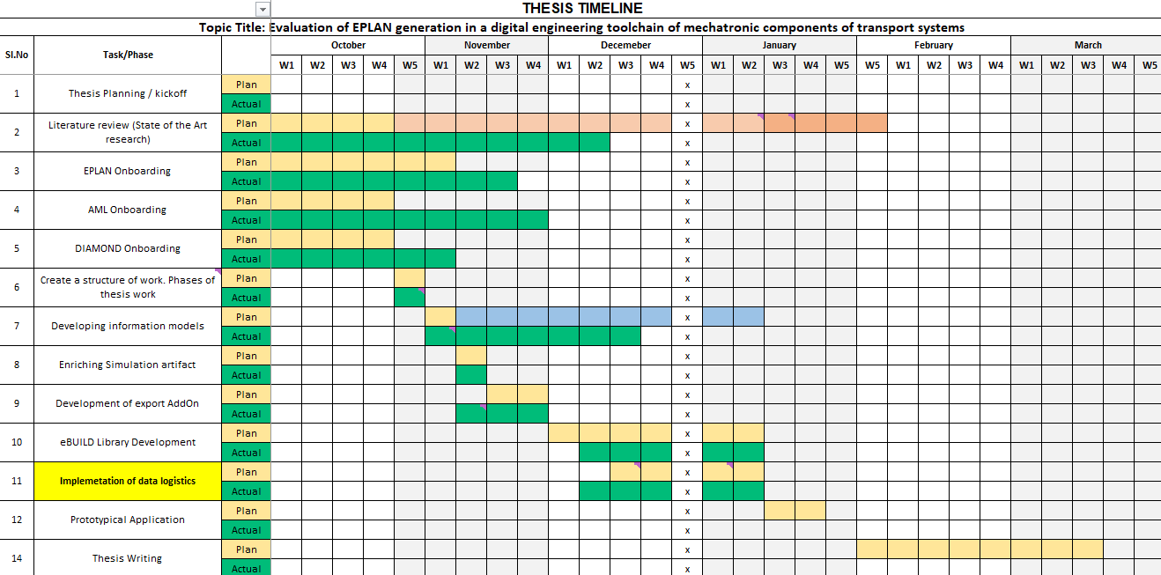
EPLAN Generation for Transport System Components
Thesis Work Overview
Table:Thesis Overview Gantt Chart

Slide 3
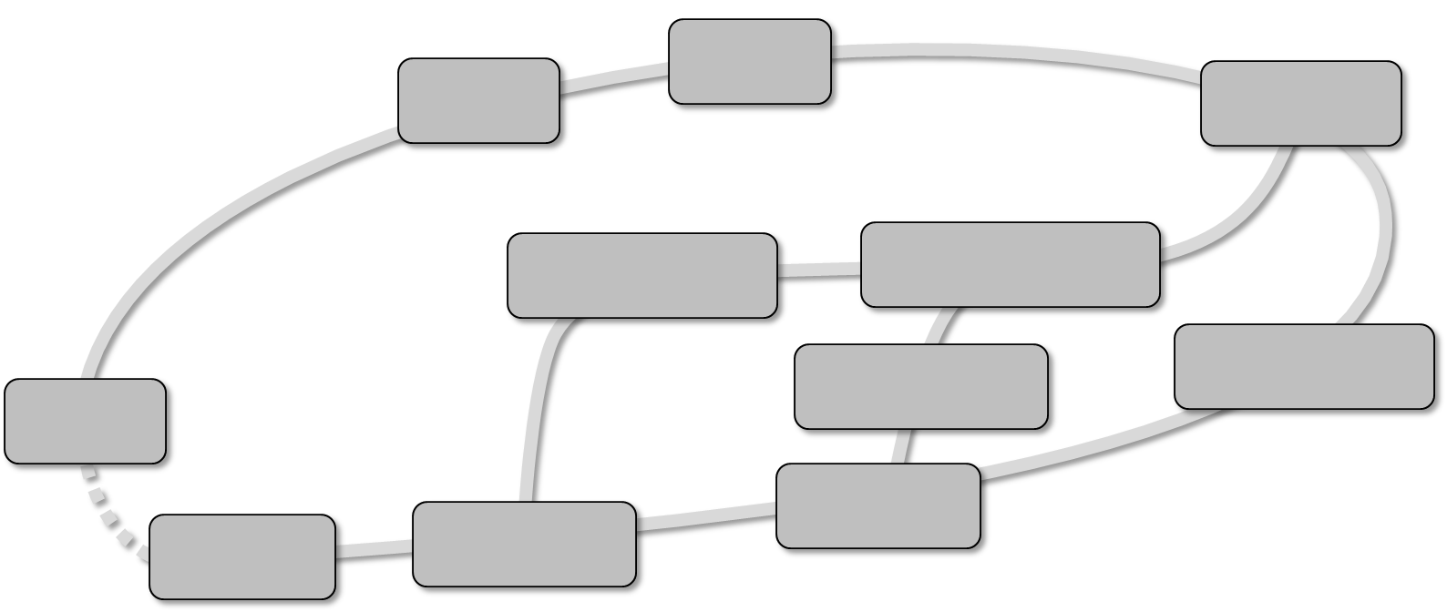
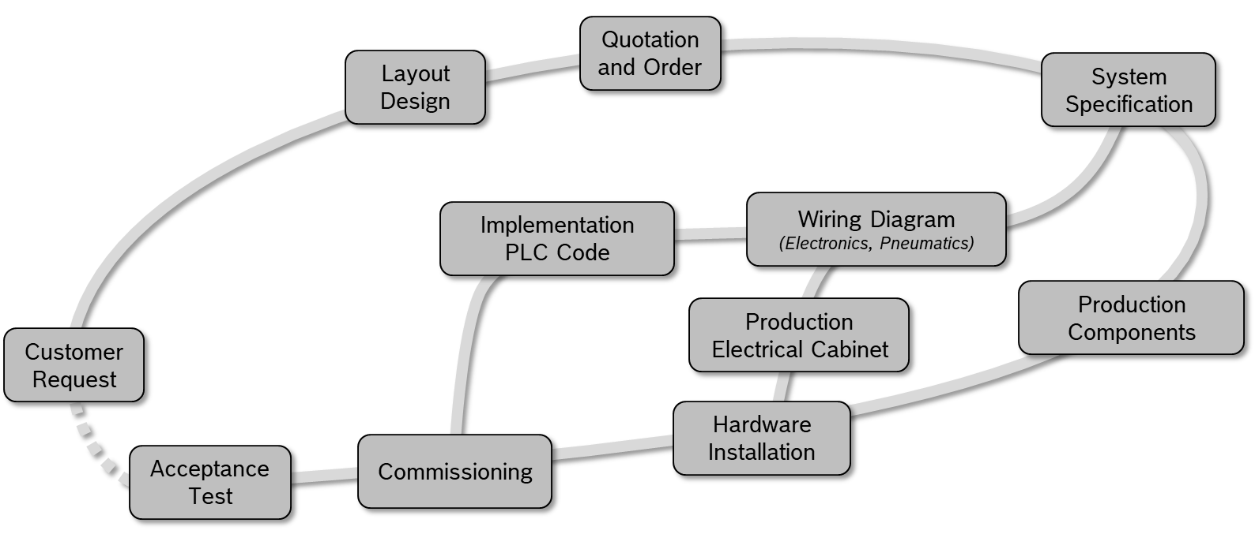
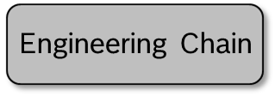
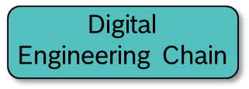
EPLAN Generation for Transport System Components
Objective
To investigate the utilization of simulation/ planning models for Bosch Rexroth’s transfer system from Visual Components for the automated generation of electrical wiring diagrams within EPLAN and develop a systematic pipeline to facilitate this automation process.
Simulation
Automated
EPLAN generation

Slide 4
EPLAN Generation for Transport System Components
Main Task
Conceptual development and prototypical application of an enhanced engineering data logistics integrating the wiring plan generation based on simulation models within the over-all engineering of production systems.
Subtask 2 : Development of Information Models
Overall Information Model
Simulation domain
Wiring Planning Data Domain / View
PPR Domain
Existing Information
Information added
Existing Information
Information added
Example Production System
VC Tool-Specific Information Model
.xml / .json
EPLAN Tool-Specific Information Model
.xlsx / .xml
Products
Process
Resources
4

Slide 5
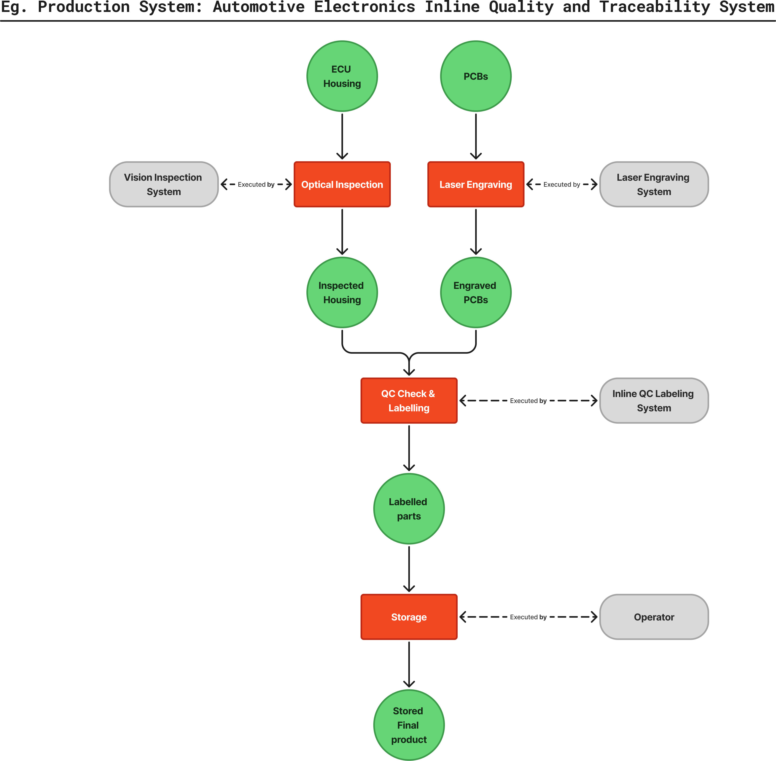
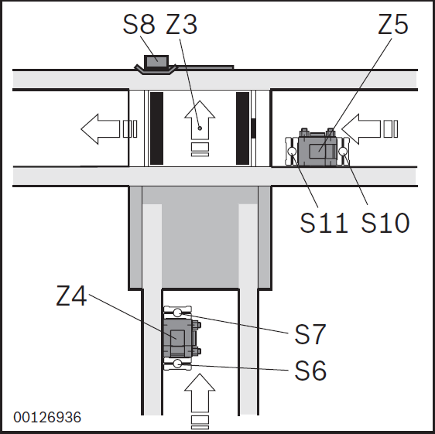
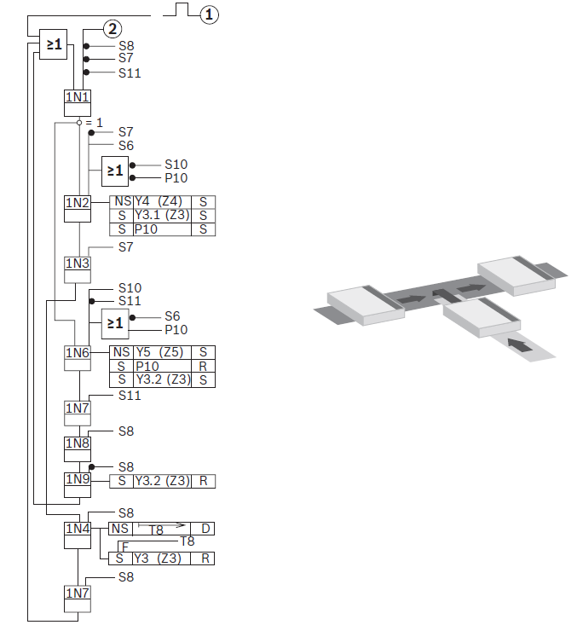
EPLAN Generation for Transport System Components
PPR diagram: Example Production System (Function Plan: TFE4)
**
**
The function plan considered for the production system is: TFE4 – Separating and Infeeding
Function Plans : Function plans are standardized function groups for transfer systems that specify control tasks by formalizing the sequence of operations, interlocks, and timing relationships between involved components.
Fig: PPR Diagram of Example Production System considered: Automotive Electronics Inline Quality Inspection and Traceability System
** ECU : Electronic Control Unit, PCB: Printed Circuit Board

Slide 6
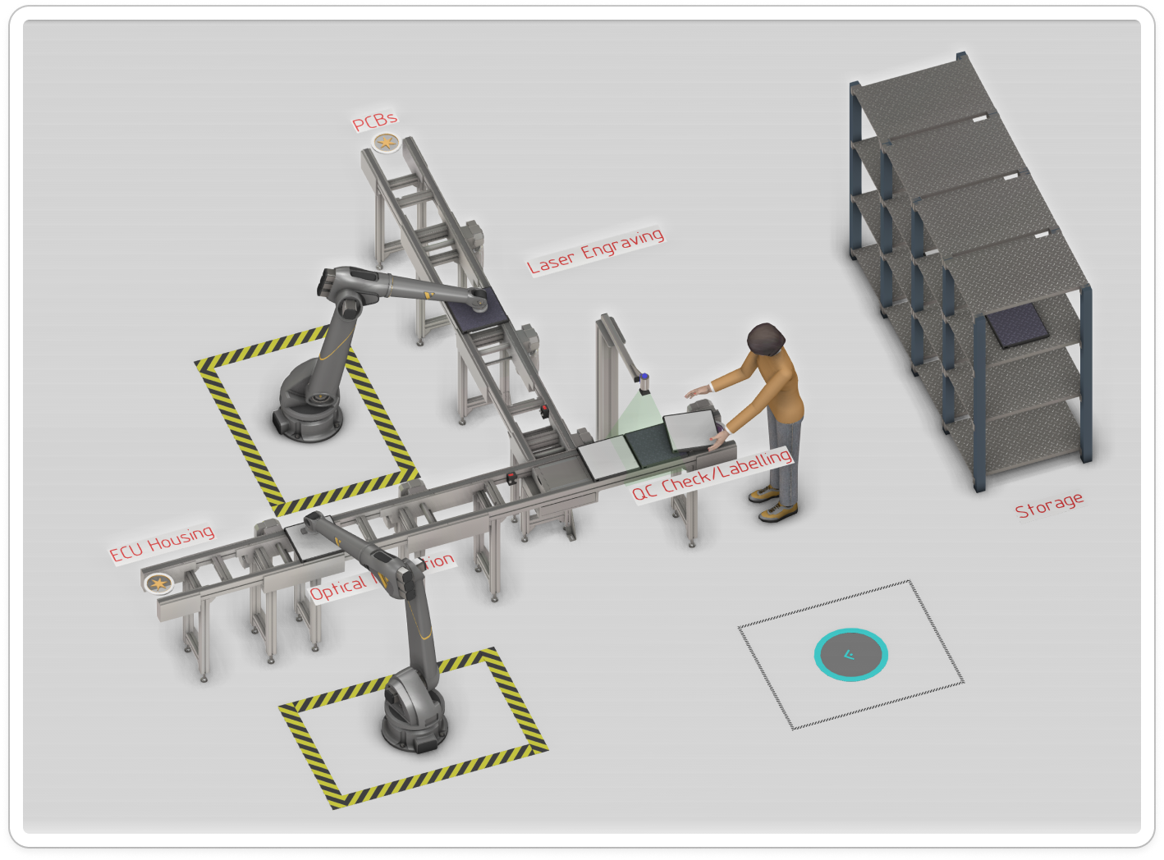
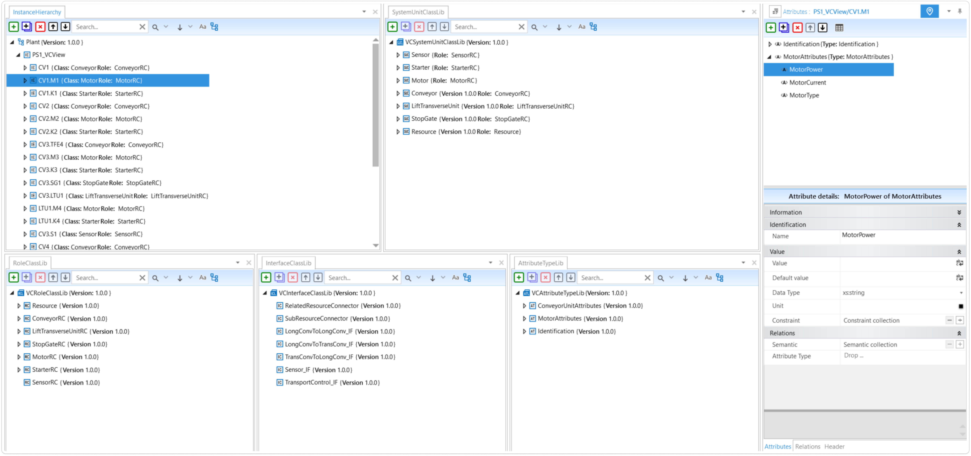
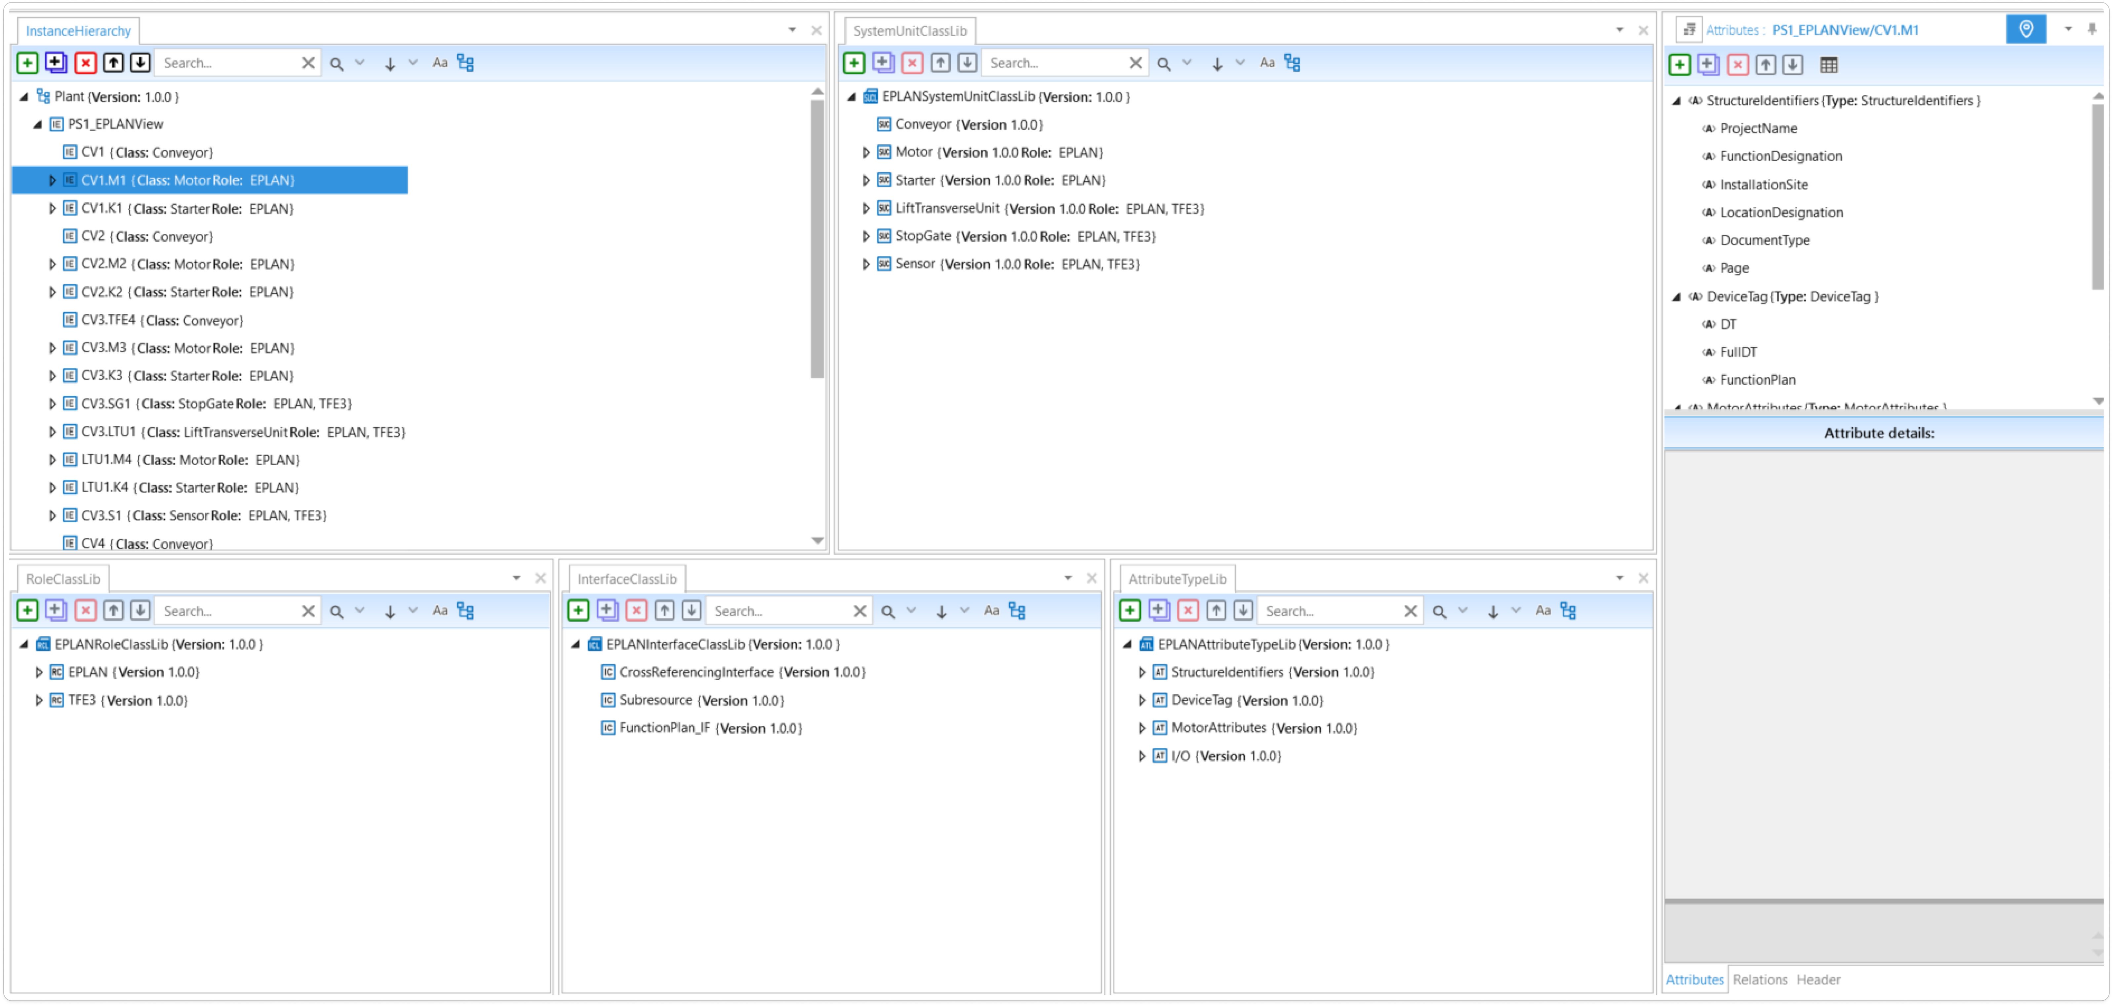
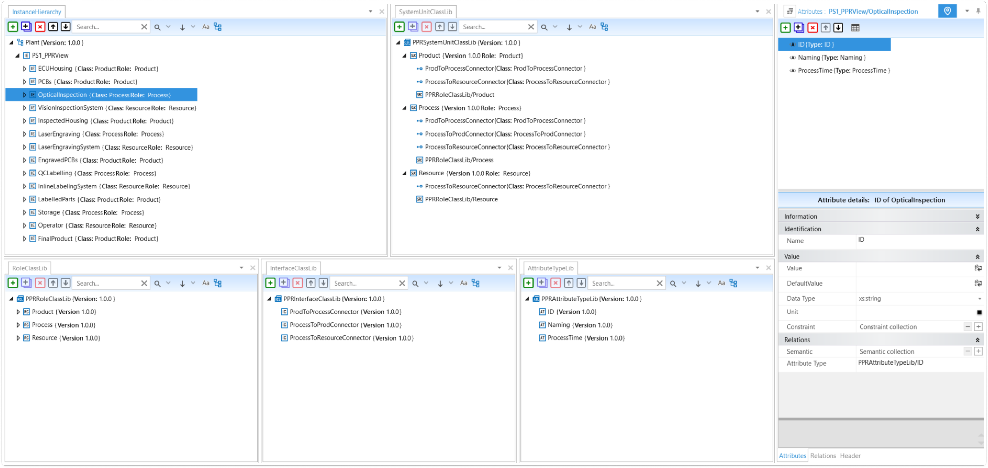
EPLAN Generation for Transport System Components
Subtasks
Example Production System in Simulation Domain: TFE4
Fig: Function Plan TFE4 Ex. Production System modelled in Visual Components (Simulation Domain)
Fig: Ex. Production System in AML: a. Visual Components (Simulation Domain) View, b. EPLAN (ECAD) Domain, c. PPR Domain

Slide 7
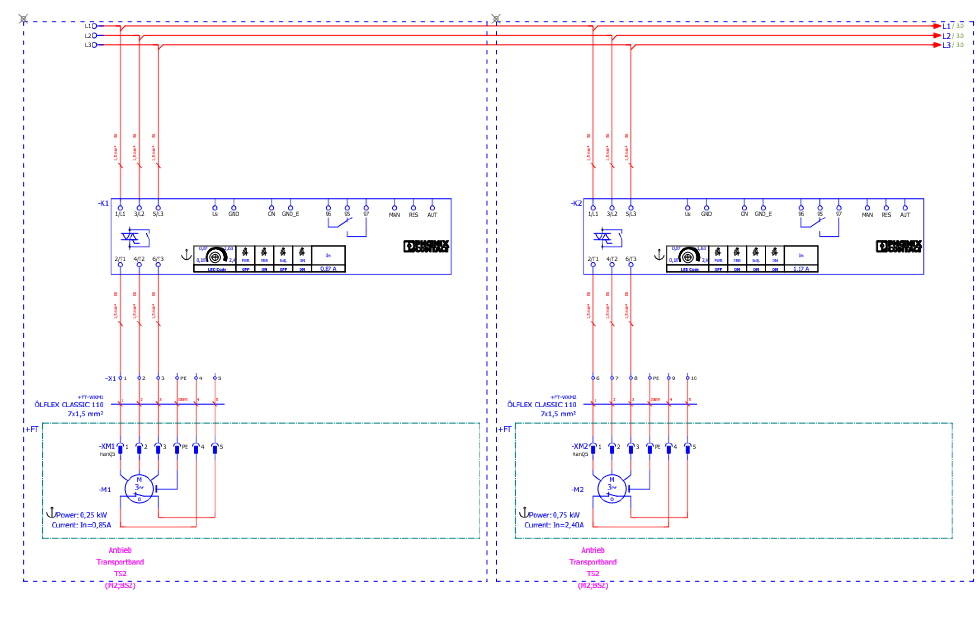
EPLAN Generation for Transport System Components
Subtasks
Example Production System in EPLAN Electric P8
To model the EPLAN schematics of the example production system, reusable macros (standardized schematic sections and symbols) are be created for each TS2 component used in the system.
The following ECAD schematic pages are generated to represent the mechatronic components of TS2 systems:
Page type - Electrical Schematic multi-line:
Conveyor Drive: Motors, Starters, Terminals
Conveyor Drive: Digital Input/Output module
Lift Transverse Unit, Stop Gate: Valve terminal Output Modules
Sensor: Input modules
Fig: TS2 Conveyor Drive Motor, Starter, Terminal Strip represented as a Window Macro

Slide 8
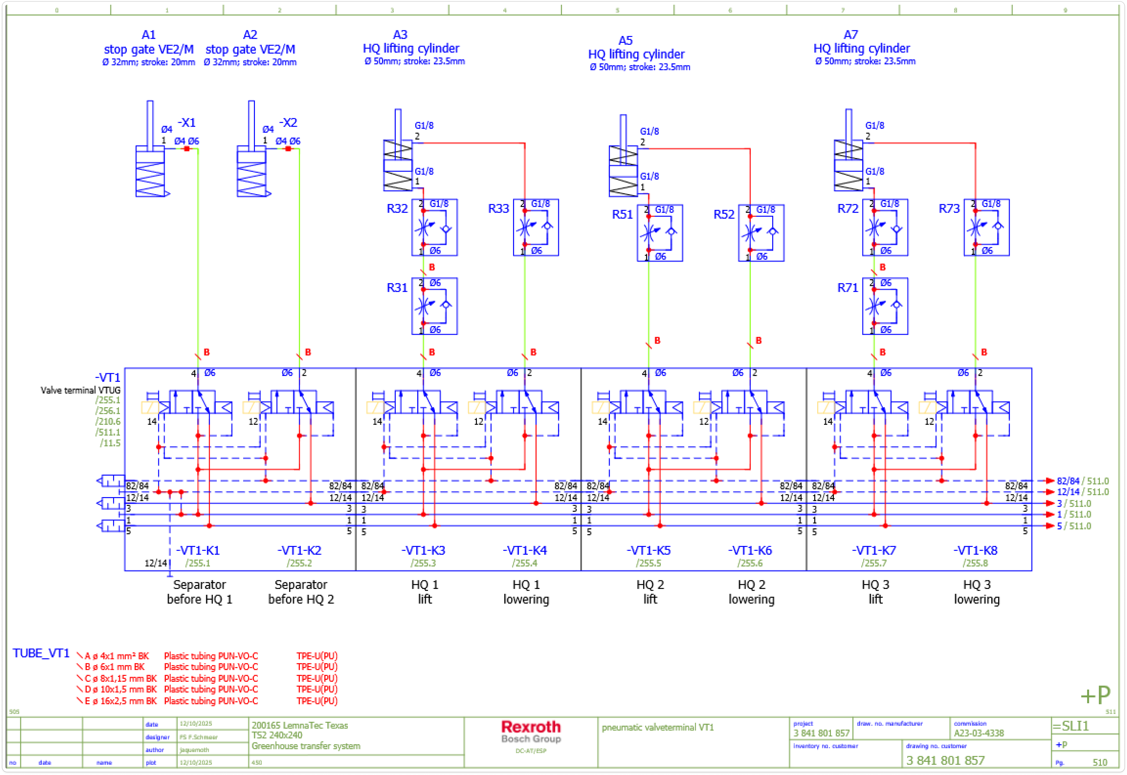
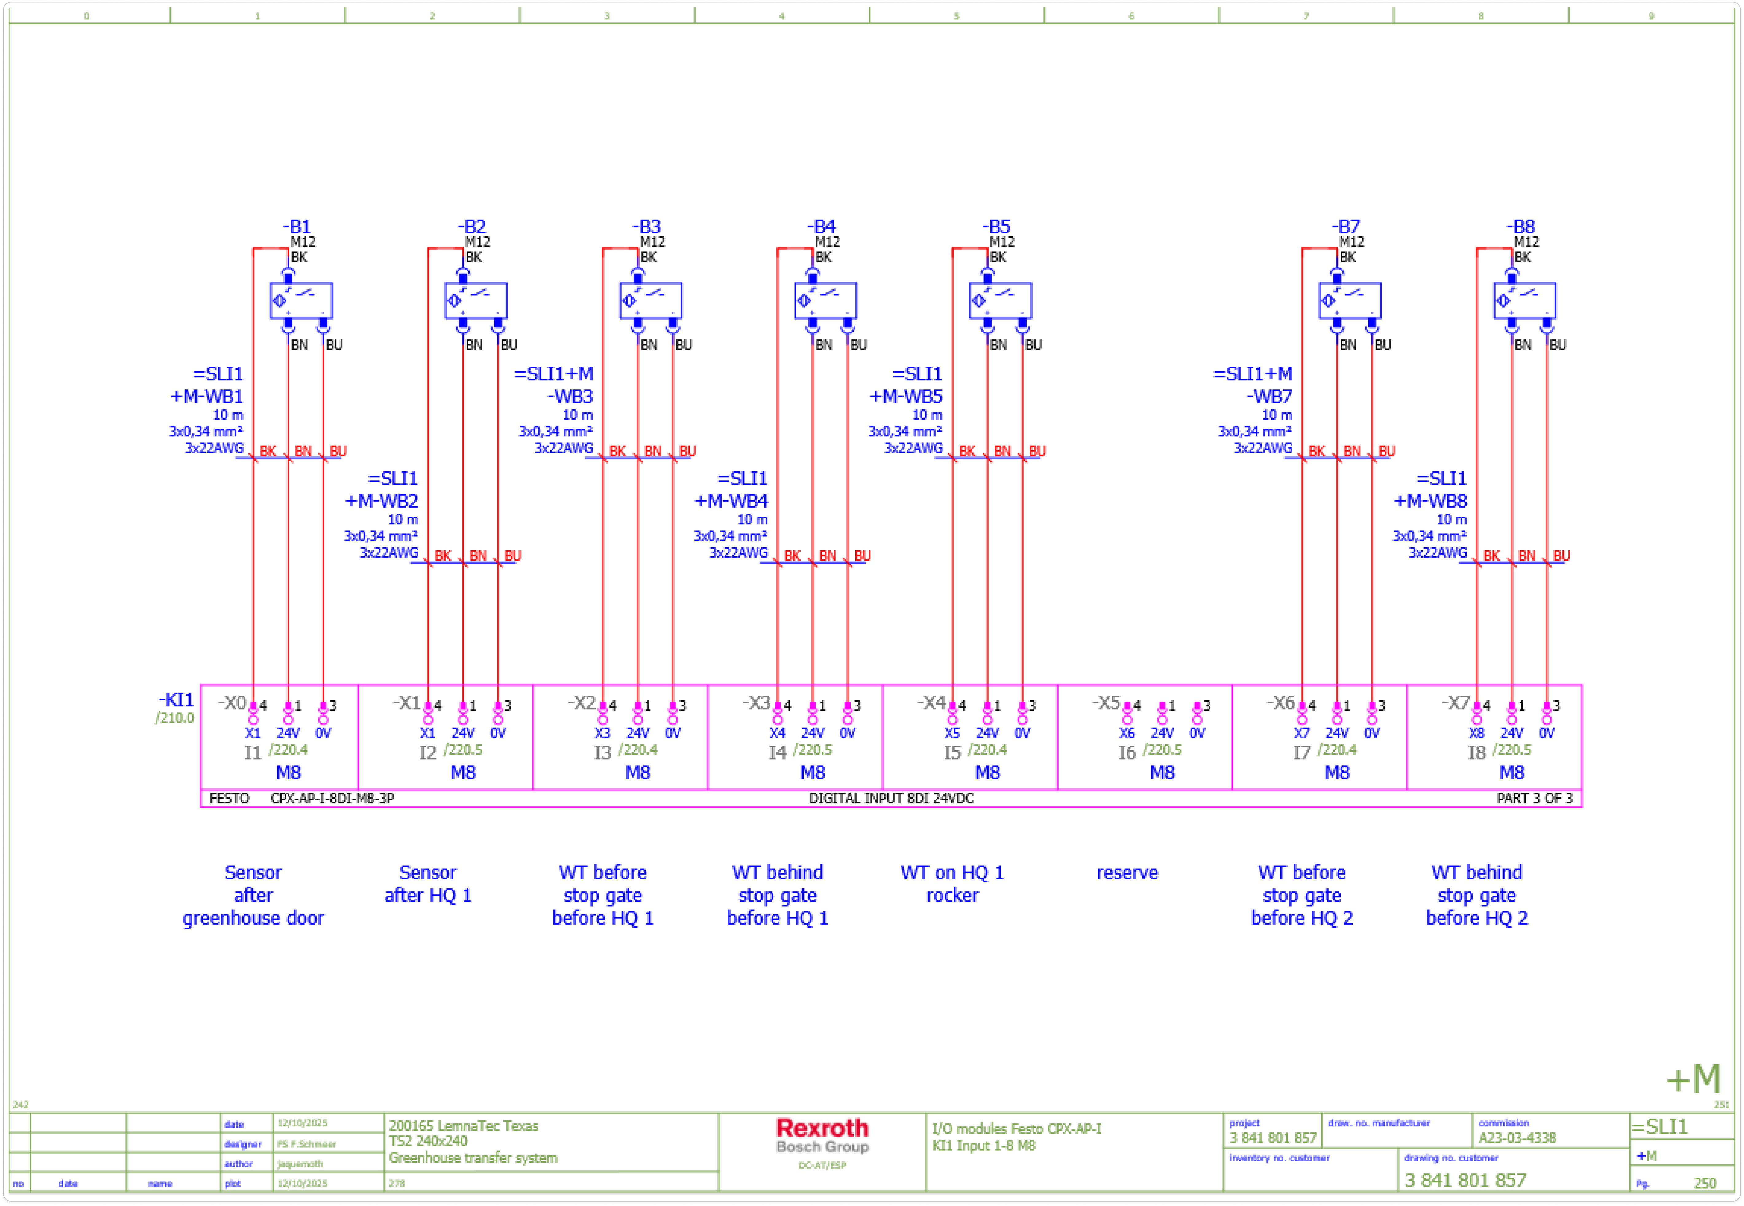
EPLAN Generation for Transport System Components
Subtasks
Example Production System in EPLAN Electric P8
The following pages are to be generated to represent the mechatronic components of TS2 systems:
Page type - Fluid Power Schematic:
Lift Transverse Unit, Stop Gate- Pneumatic Valve terminal
The macros required to generate the above schematic pages for the mechatronic components of the TS2 system were created.
Based on these macros, macro typicals, typical groups incorporating placeholder objects and configuration variables were developed.
Fig: TS2 LTU- Valve Terminal Fluid Power Schematic
Fig: TS2 Sensor- DI module Electrical Schematic

Slide 9
EPLAN Generation for Transport System Components
Overall Information Flow between domains for an Eg. Production System

Slide 10
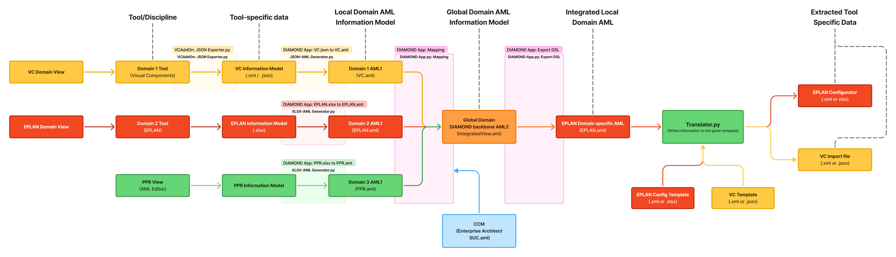
EPLAN Generation for Transport System Components
High Level Engineering Data Logistics Workflow
FunctionPlan = TFE4
FunctionPlan = TFE4
Conv1=VC1
FunctionPlan

Slide 11
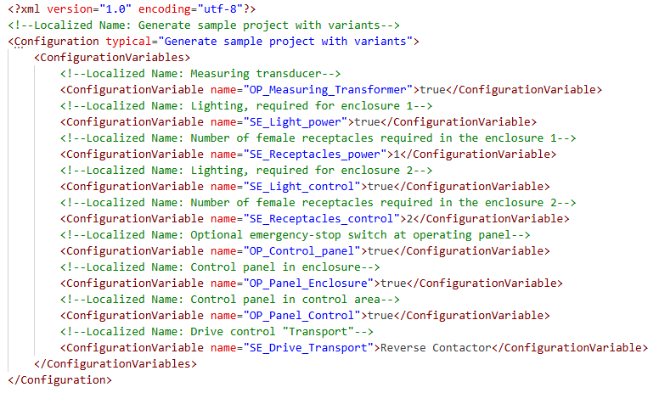
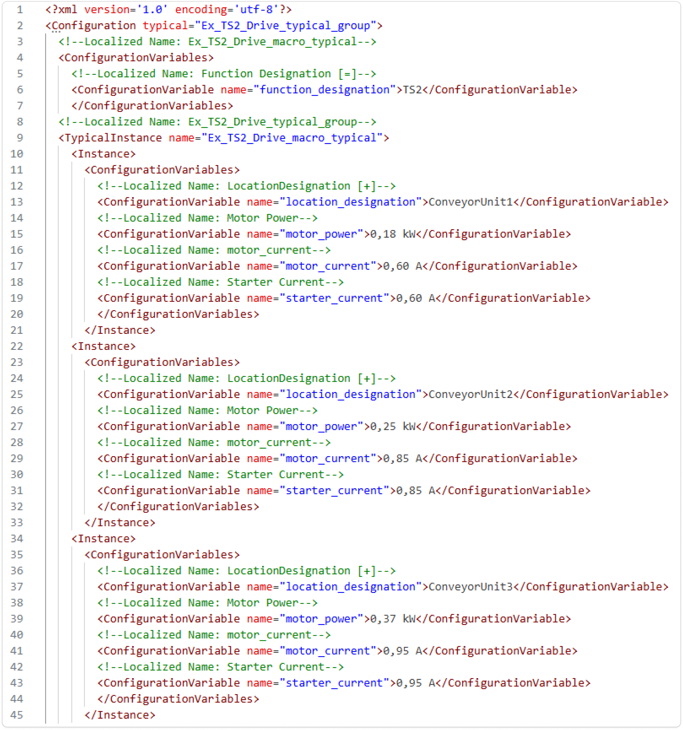
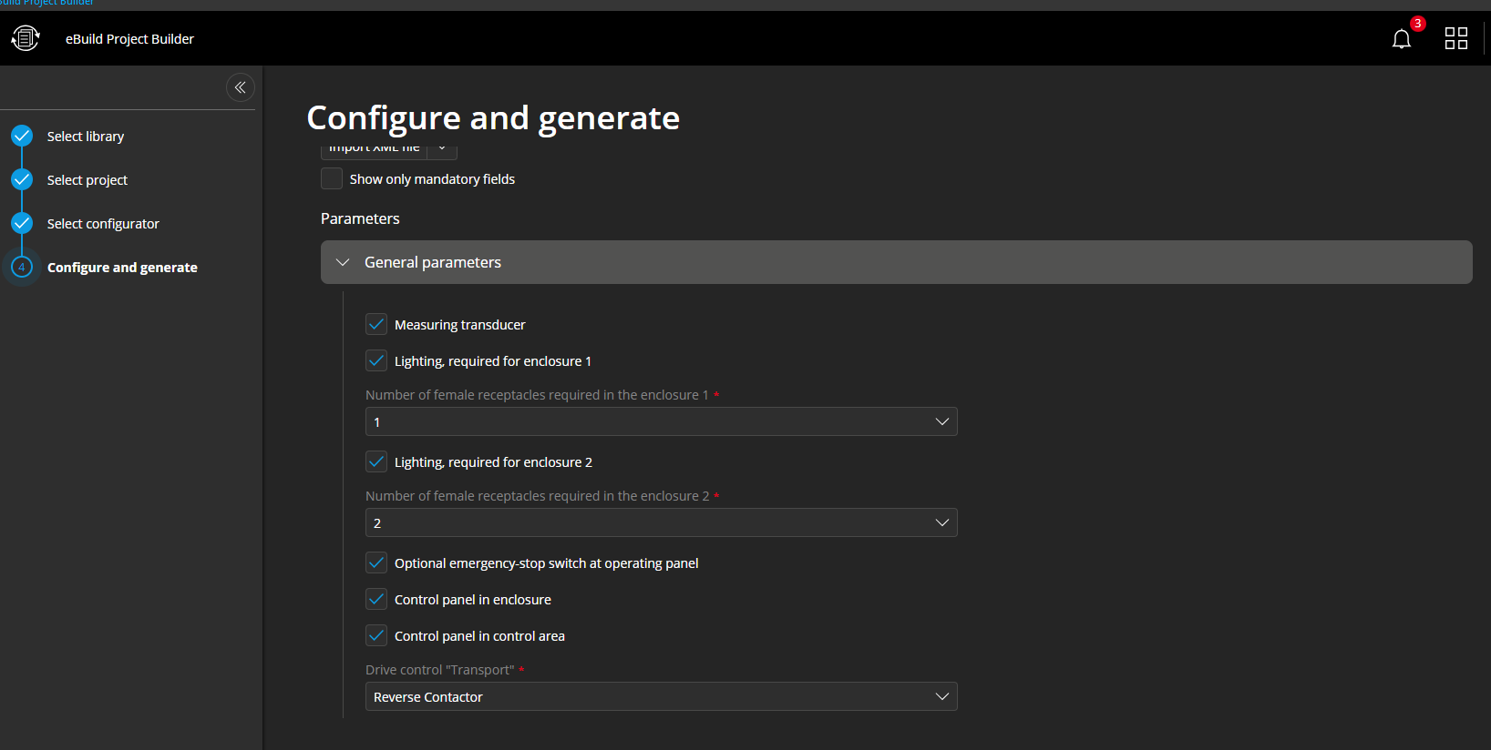
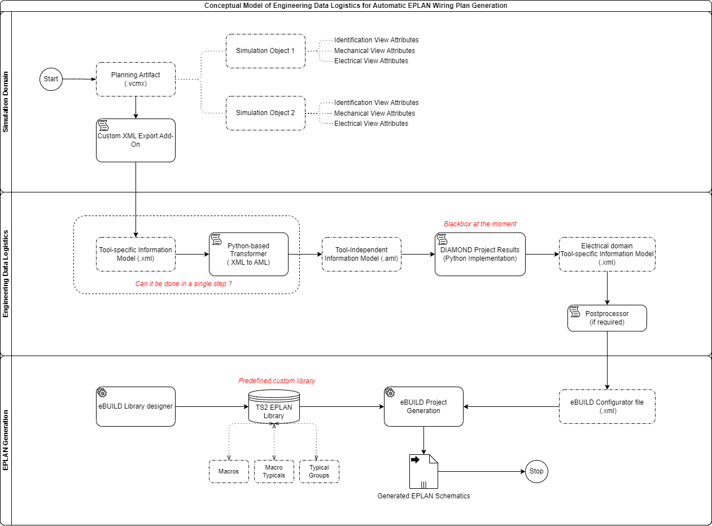
EPLAN Generation for Transport System Components
EPLAN eBUILD (Cloud based Schematic Generator)
EPLAN eBUILD Workflow:
Fig: EPLAN eBUILD Project generation from predefined libraries and configurators
Fig: EPLAN example eBuild configuration file (.xml)
Fig: eBUILD Configurator UI
eBUILD Project Generation, utilizes preconfigured library consisting of macros, macro typicals, typical groups and configurators to automatically generate EPLAN schematics based on a configuration file.
eBUILD Project Generation supports .xml / .xlsx import of configurations for schematic generation.
Values for these placeholder configuration variables, generation rules, constraints in the configuration file is derived from the EPLAN domain export from the integrated Common Data Model (CDM)

Slide 12
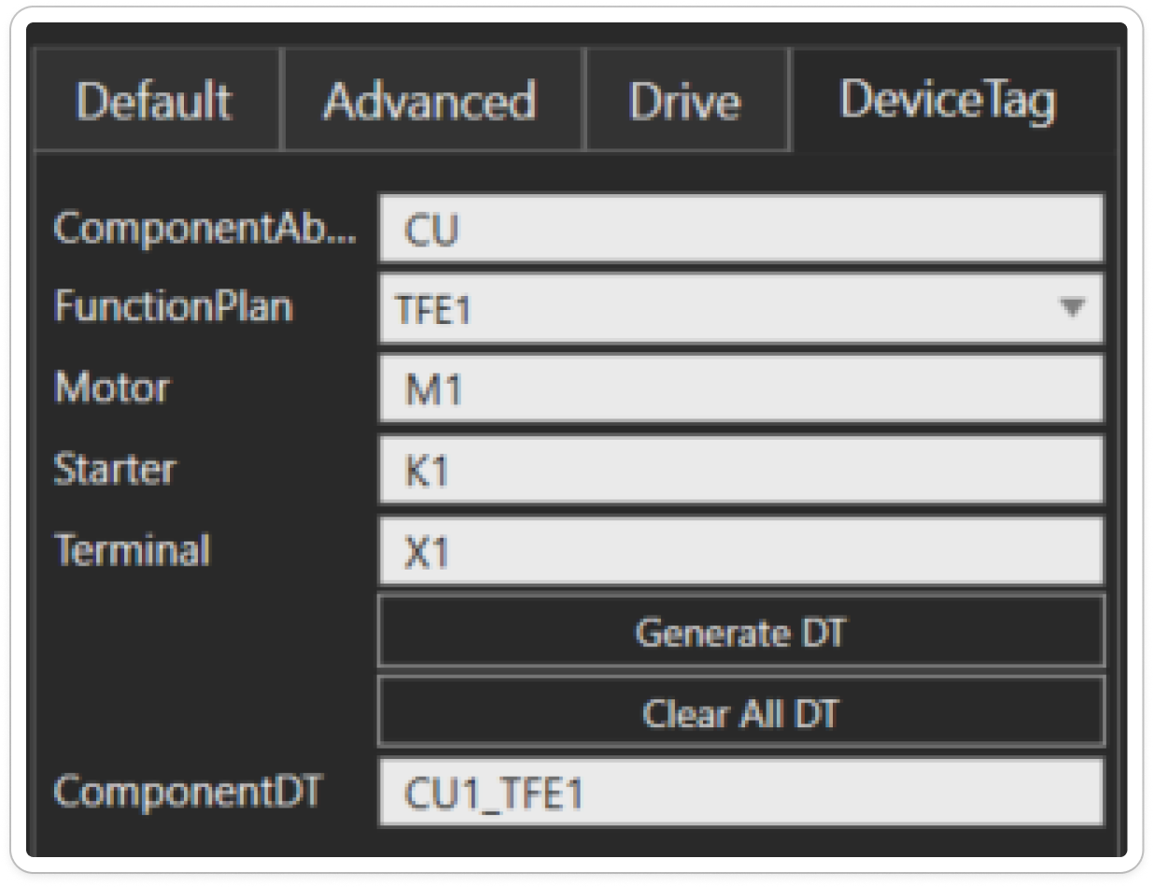
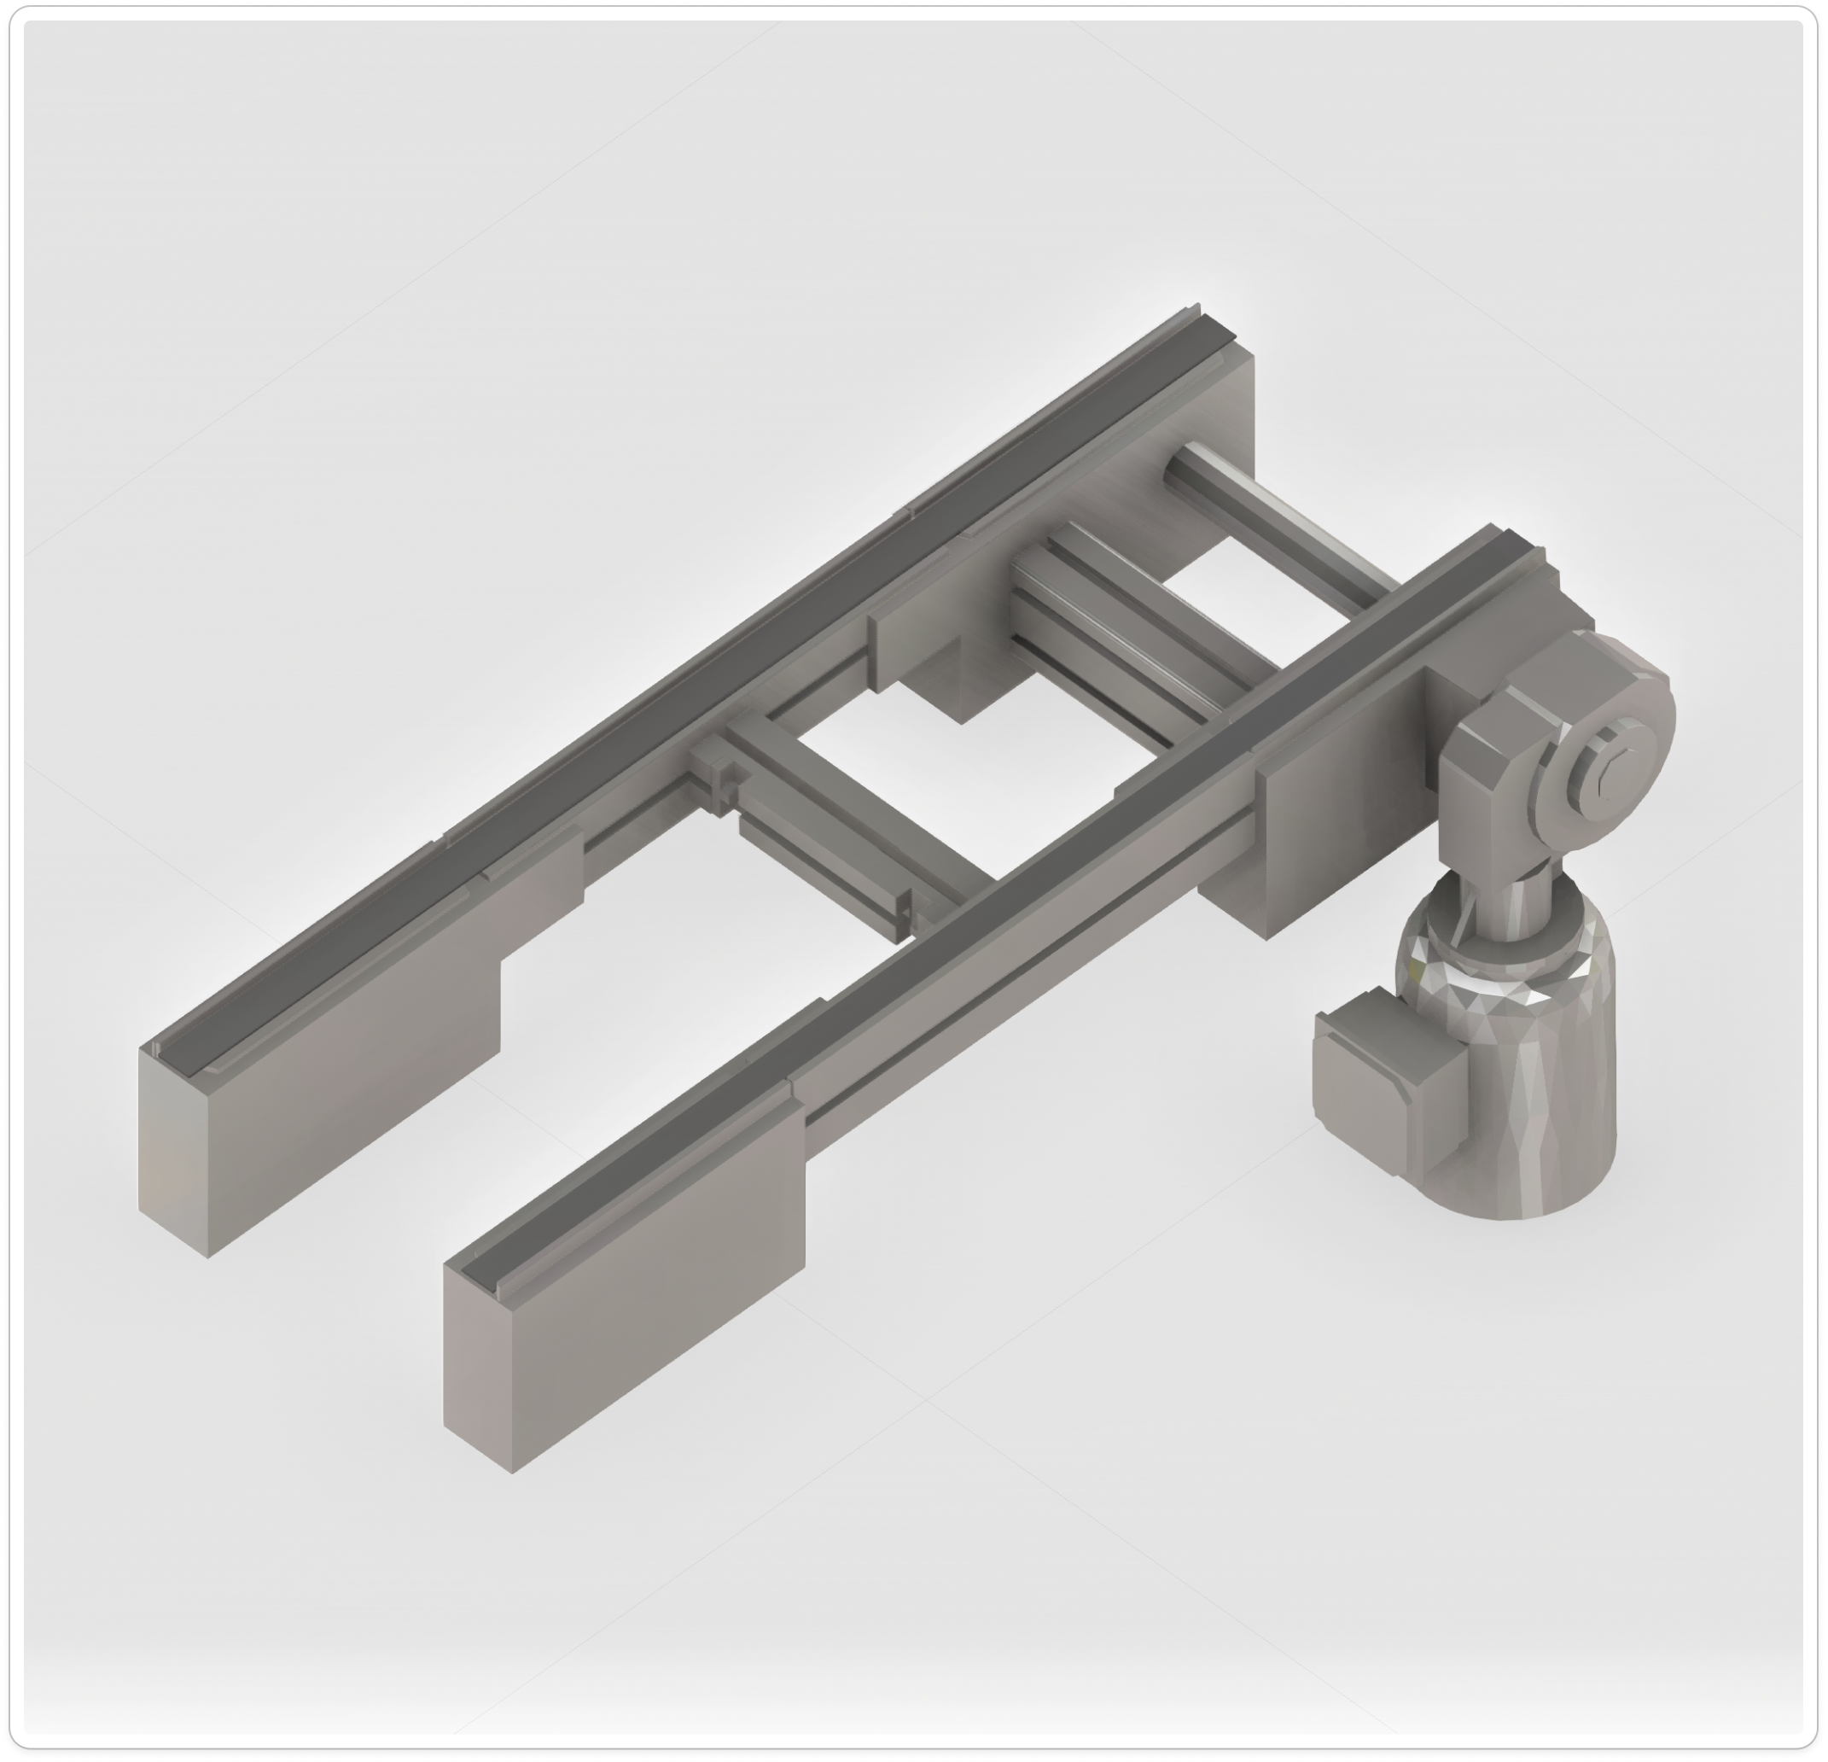
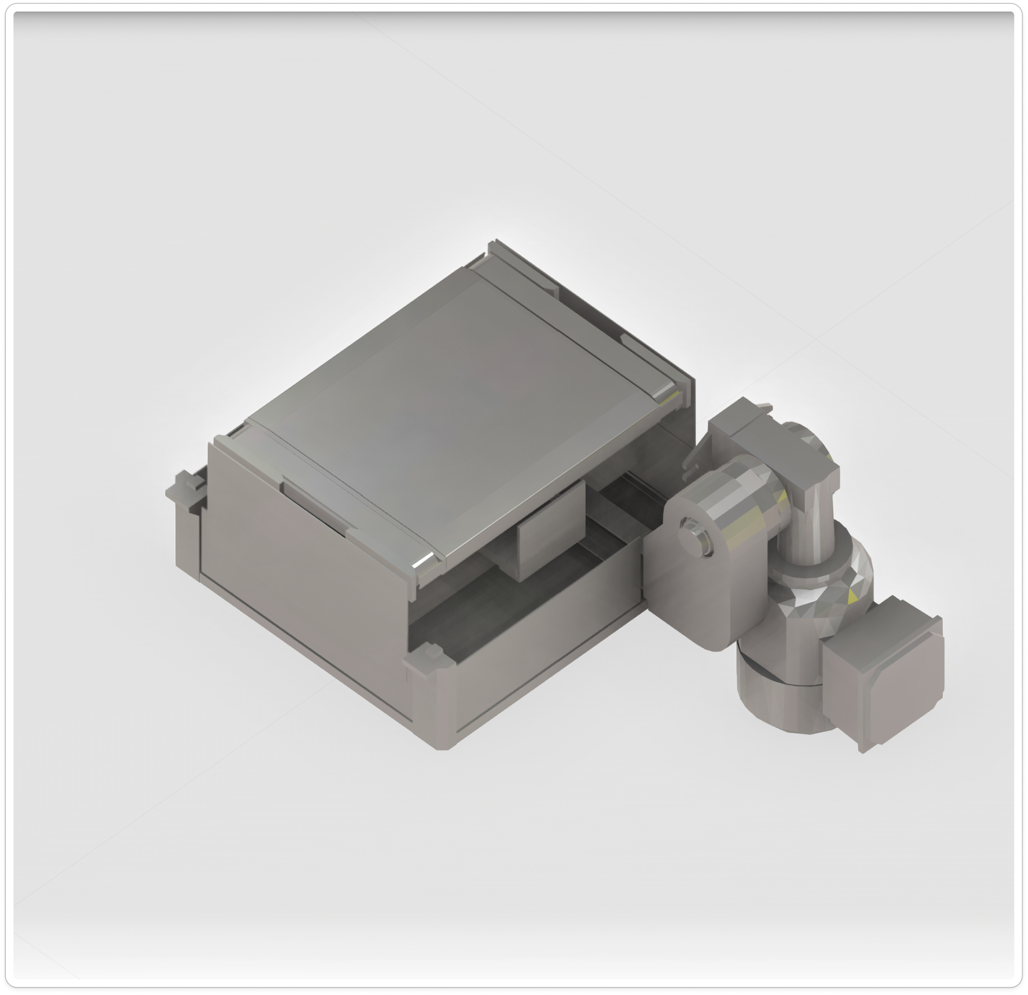
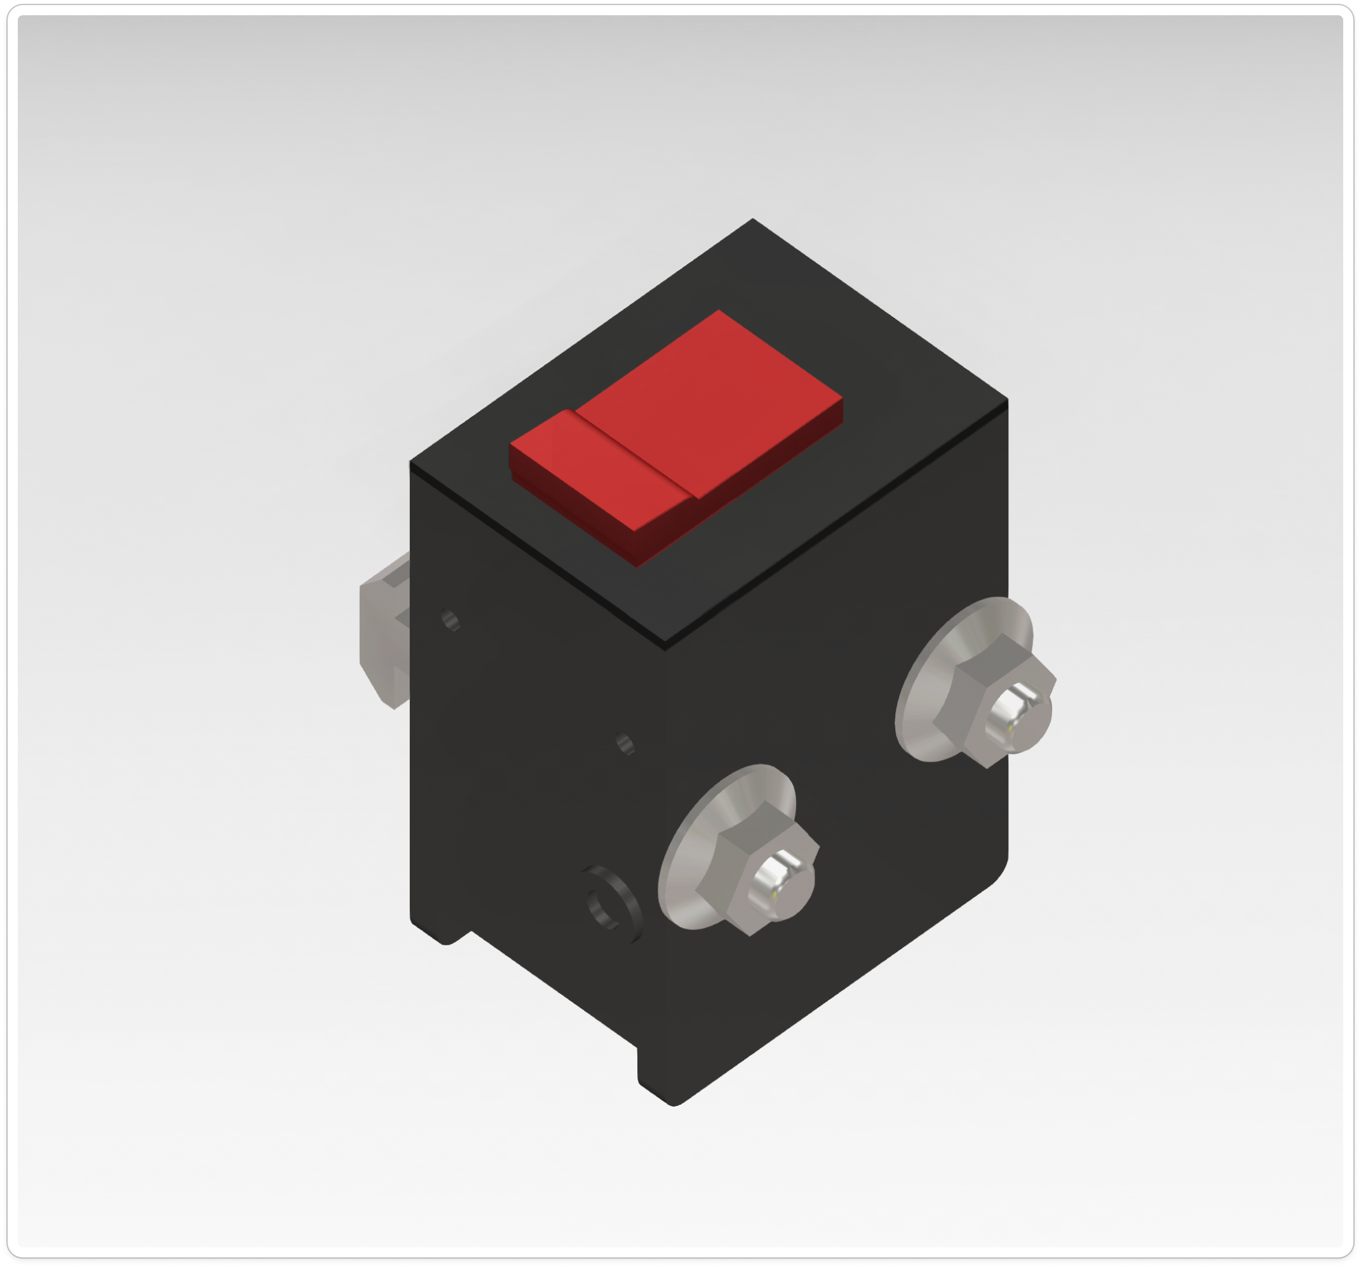
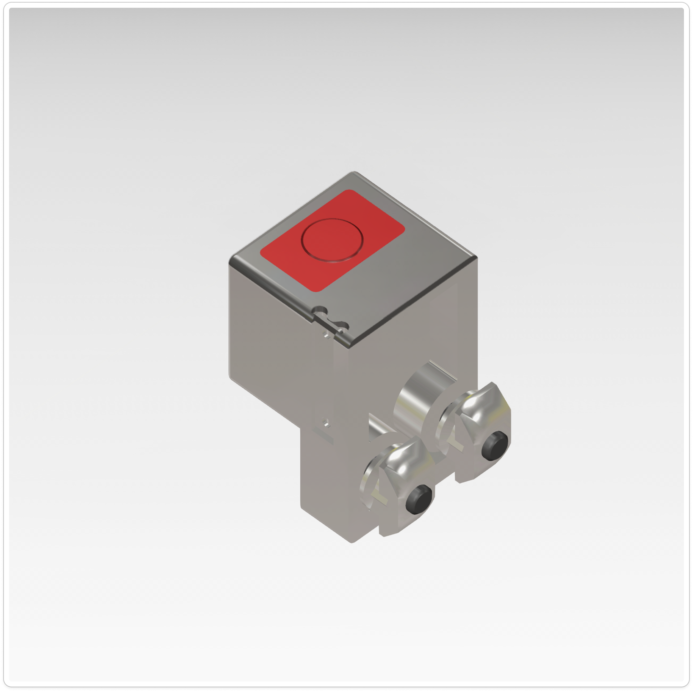
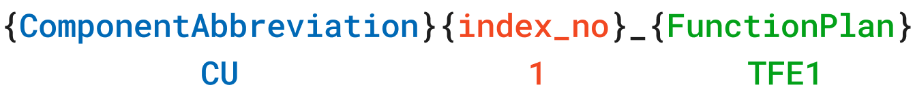
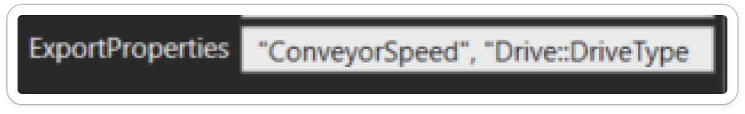
EPLAN Generation for Transport System Components
Modification of TS2 Simulation Objects in VC to facilitate data export
Fig: a) Conveyor Unit, b) Lift Transverse Unit, c) Stop Gate, d) Switch Bracket (Sensor)
Fig: Top- Device Tag generation for Conveyor unit and sub resources. Bottom- Export Properties string attribute to notify python exporter the attributes to be exported.
Extended TS2 Simulation objects by adding electrical attributes identified for EPLAN generation and in accordance with Transfer System 2 product documentation.
Implemented internal python logic to generate a unique identifier Device Tag (DT) for each instantiated simulation object.
Introduced an export string property, consisting of comma separated attribute list of each component, that specifies which component attributes and behaviors shall be included by the exporter add-on during data export.

Slide 13
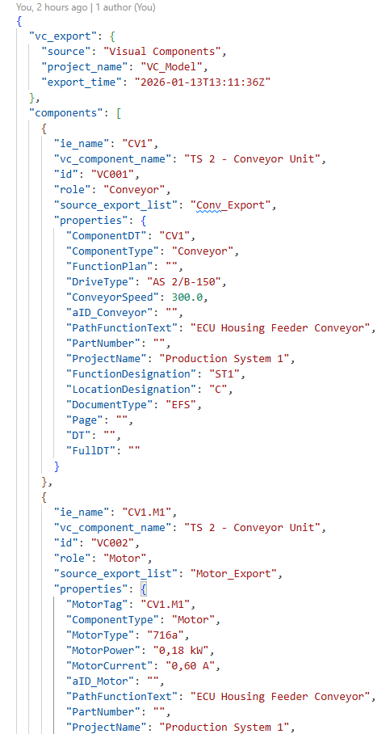


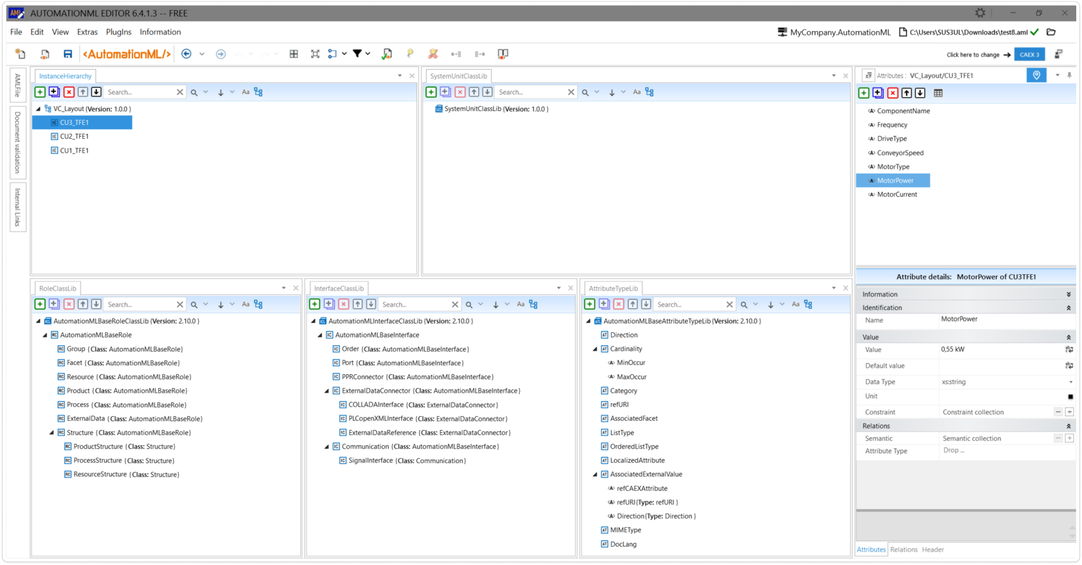
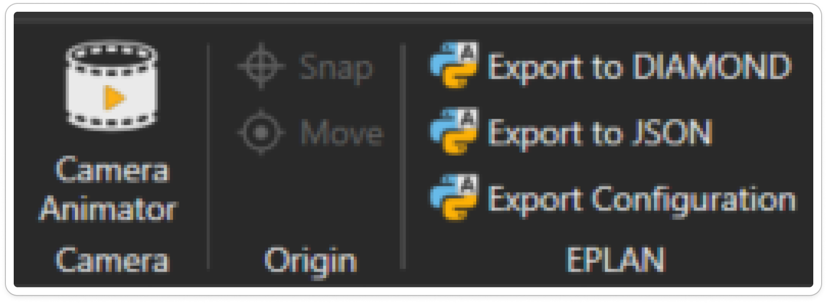



EPLAN Generation for Transport System Components
Domain-Specific AML Generation Pipeline from Visual Components
A custom python based AddOn for Visual Components was developed to extract relevant information of the mechatronic components present in the planning artifact and export it to a Domain specific data format.
The exported data is transformed into a domain-specific AutomationML instance hierarchy using predefined mapping schema and the System Unit Classes (SUCs) of the example production system exported from the Enterprise Architect Common Concept model (CCM).
Common Concept Model of Example Production System in Enterprise Architect
CAEX 3.0 Schema
To instantiate
Instance hierarchy
as input
generates
VC Domain Specific
AML Generator
(Python 3.x)
Custom Python Add-on for
Visual Components
(Python <2.7)

Slide 14
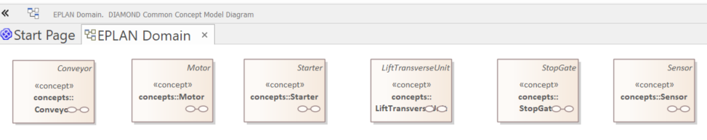
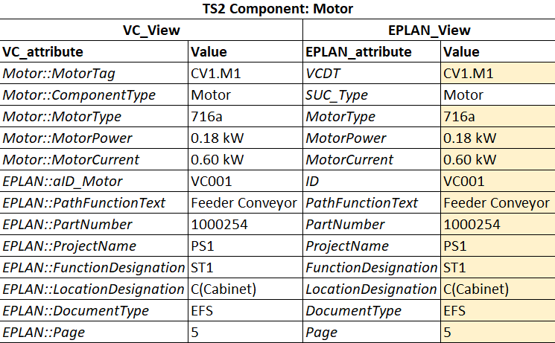
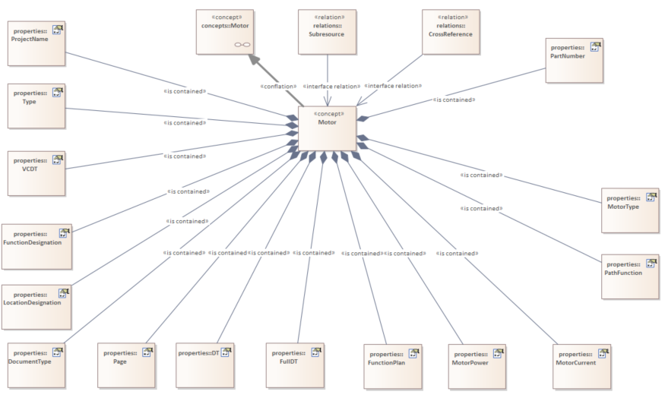
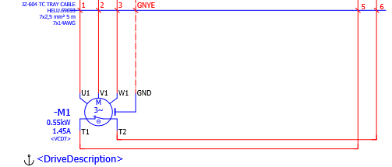
EPLAN Generation for Transport System Components
SUC generation from Common Concept Model in Enterprise Architect (EA)
Modelled Common Concepts Diagram in EA for each view with defined attributes, relations to generate AML System Unit Classes (SUCs) for the Eg. Production System using RAMI 4.0 toolbox Add In.
Fig: Left: EPLAN Domain DIAMOND Common Concept Model Diagram for the Eg. Production System (CC: Motor) , Right: Motor Concept Attributes in VC_View and EPLAN_View

Slide 15
EPLAN Generation for Transport System Components
Next Steps/ Work in progress
Utilizing the knowledge from DIAMOND PPR-AML tool to integrate the domain specific views and generate global domain integrated AML information model / DIAMOND Common Data Model.
Implementing a python-based exporter to EPLAN domain specific model from DIAMOND backbone followed by implementation of configuration template-based python translator to map information exported from DIAMOND backbone to create the eBUILD configurator file.
Developing EPLAN eBUILD library for typical groups (Fluid power schematic, Electrical multi line schematic) and configurator for the TS2 components: Conveyor drives, Lift Transverse Unit, Stop gate and Sensors.
Validating the complete engineering data logistics pipeline using a simplified simulation system and subsequently apply the validated approach to the example production system.

Slide 16
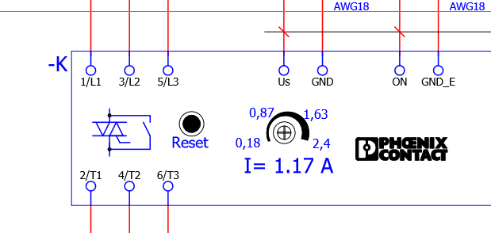
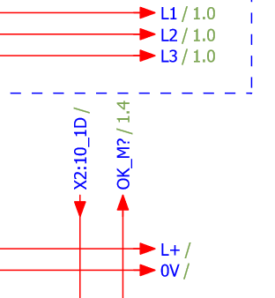
EPLAN Generation for Transport System Components
Open points
EPLAN – How can automatic numbering of Device Tags (DTs) for the generated eBUILD schematics be achieved? At present the generated schematics does not generate automatically numbered DTs for devices.
EPLAN - How can interruption points be defined and connected with required cross-referencing for generated schematics using typical groups? (How can this cross-referencing information be included in eBUILD?)
Interruption points denote the continuation of auto connecting lines through multiple columns or pages of the schematic. Interruption points are used where certain potentials or signals must be spread over multiple schematic pages.
Fig: Eg. Motor starter DT (-K) not numbered automatically
Fig: Eg. Interruption points for the AC Power rails

Slide 17
THANK YOU

